Slide 1



SDA
Academy
SMART TUBE
ASSISTANT
Presented by: Mehdar Saggaf

Slide 2
Agenda
Pain
Aim of
Project
Project Structure
Project Deployment
Future Goals

Slide 3
Agenda
Pain
Aim of
Project
Project Structure
Project Deployment
Future Goals

Slide 4
Agenda
Pain
Aim of
Project
Project Structure
Project Deployment
Future Goals

Slide 5
Agenda
Pain
Aim of
Project
Project Structure
Project Deployment
Future Goals

Slide 6
Agenda
Pain
Aim of
Project
Project Structure
Project Deployment
Future Goals

Slide 7
Agenda
Pain
Aim of
Project
Project Structure
Project Deployment
Future Goals

Slide 8

PAIN

Slide 9
PAIN
01
02
03
04

Slide 10
PAIN
01
I waste a lot of time watching full videos to find important information.
02
03
04

Slide 11
PAIN
01
I waste a lot of time watching full videos to find important information.
02
Taking notes manually is tiring and slow.
03
04

Slide 12
PAIN
01
I waste a lot of time watching full videos to find important information.
02
Taking notes manually is tiring and slow.
03
it’s hard to study efficiently without fast summaries.
04

Slide 13
PAIN
01
I waste a lot of time watching full videos to find important information.
02
Taking notes manually is tiring and slow.
03
it’s hard to study efficiently without fast summaries.
04
I need a way to ask questions about the video content directly.

Slide 14

01
AIM
02
03
04

Slide 15
AIM
01
Save users time by summarizing long YouTube videos.
02
03
04

Slide 16
AIM
01
Save users time by summarizing long YouTube videos.
02
Help student study better with organized, educational summaries.
03
04

Slide 17
AIM
01
Save users time by summarizing long YouTube videos.
02
Help student study better with organized, educational summaries.
03
Allow users to ask questions and get instant answers based on the video.
04

Slide 18
AIM
01
Save users time by summarizing long YouTube videos.
02
Help student study better with organized, educational summaries.
03
Allow users to ask questions and get instant answers based on the video.
04
Offer downloadable summaries for offline study (PDF format).

Slide 19

Project Structure

Slide 20

SmartTube Assistant

Slide 21
SmartTube Assistant
Data

Slide 22
SmartTube Assistant
Data
Util

Slide 23
SmartTube Assistant
Data
Util
App.py

Slide 24
SmartTube Assistant
Data
Util
App.py
Templates

Slide 25
SmartTube Assistant
Data
Util
App.py
Templates
-Store The Data Using Chroma DB
Video_Audio
Summary
Transcrip

Slide 26
SmartTube Assistant
Data
Util
App.py
Templates

Slide 27
SmartTube Assistant
YouTube:
Data
Download audio from Youtube video.
Util
App.py
Templates

Slide 28
SmartTube Assistant
YouTube:
Download audio from Youtube video.
Data
Util
App.py
Templates
Whisper:
Converts audio to text.

Slide 29
SmartTube Assistant
YouTube:
Download audio from Youtube video.
Data
Util
App.py
Templates
Whisper:
Converts audio to text.
Agent Memory Chain:
Saves chat history.

Slide 30
SmartTube Assistant
YouTube:
Download audio from Youtube video.
Data
Util
App.py
Templates
Whisper:
Converts audio to text.
Agent Memory Chain:
Saves chat history.
QA:
Take questions, Return answers.

Slide 31
SmartTube Assistant
YouTube:
Download audio from Youtube video.
Data
Util
App.py
Templates
Whisper:
Converts audio to text.
Agent Memory Chain:
Saves chat history.
QA:
Take questions, Return answers.
Summary:
-Regular Summary
-Tutorial Summary
-Story-Telling Summary
+ Download PDF

Slide 32
SmartTube Assistant
YouTube:
Download audio from Youtube video.
Data
Util
App.py
Templates
Whisper:
Converts audio to text.
Agent Memory Chain:
Saves chat history.
QA:
Take questions, Return answers.
Summary:
-Regular Summary
-Tutorial Summary
-Story-Telling Summary
+ Download PDF

Slide 33
SmartTube Assistant
Data
Util
App.py
Templates

Slide 34
SmartTube Assistant
Data
Util
App.py
Templates
-Website Back-end

Slide 35
SmartTube Assistant
Data
Util
App.py
Templates

Slide 36
Evaluation

Slide 37
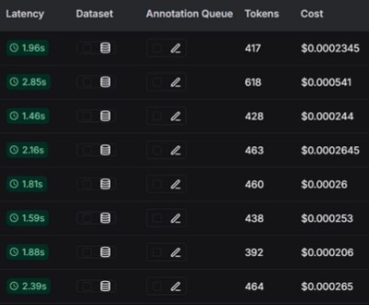
Evaluation
Q&A without search history

Slide 38
Evaluation
RAG system
what is the main points in the video?
user query
embedding
Football match video
cosin similarity
user
chroma DB
video transcript
Main points are:
1- football match between two teams
2- Team blue wins
3- Team yellow losses
Q&A without chat history
LMM

Slide 39
Evaluation
RAG system
what is the second important point?
user query
embedding
Football match video
cosin similarity
user
chroma DB
video transcript
Q&A without chat history
I don’t know
LMM

Slide 40
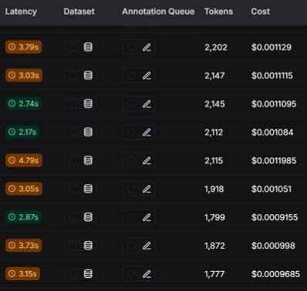
Evaluation
Q&A with search history

Slide 41
Evaluation
RAG system(Agent)
what is the main points of the video?
user query
embedding
Football match video
cosin similarity
user
chroma DB
chroma DB
chat history
video transcript
Agent
LMM
Main points are:
1- football match between two teams
2- Team blue wins
3- Team yellow losses
Q&A with chat history

Slide 42
Evaluation
what is the second important point?
RAG system(Agent)
user query
embedding
Football match video
cosin similarity
user
chroma DB
chroma DB
chat history
video transcript
Agent
LMM
Second important point is: Blue team wins
Q&A with chat history

Slide 43
SmartTube Assistant
Data
Util
App.py
Templates

Slide 44
SmartTube Assistant
Data
Util
App.py
Templates
Base.html

Slide 45
SmartTube Assistant
Data
Util
App.py
Templates
Base.html
ChatBot.html

Slide 46
SmartTube Assistant
Data
Util
App.py
Templates
Base.html
ChatBot.html
Choice.html

Slide 47
SmartTube Assistant
Data
Util
App.py
Templates
Base.html
ChatBot.html
Choice.html
Home.html

Slide 48
SmartTube Assistant
Data
Util
App.py
Templates
Base.html
ChatBot.html
Choice.html
Home.html
Summary.html

Slide 49
SmartTube Assistant
Data
Util
App.py
Templates
Base.html
ChatBot.html
Choice.html
Website Front-end
Home.html
Summary.html

Slide 50
Project Deployment

Slide 51
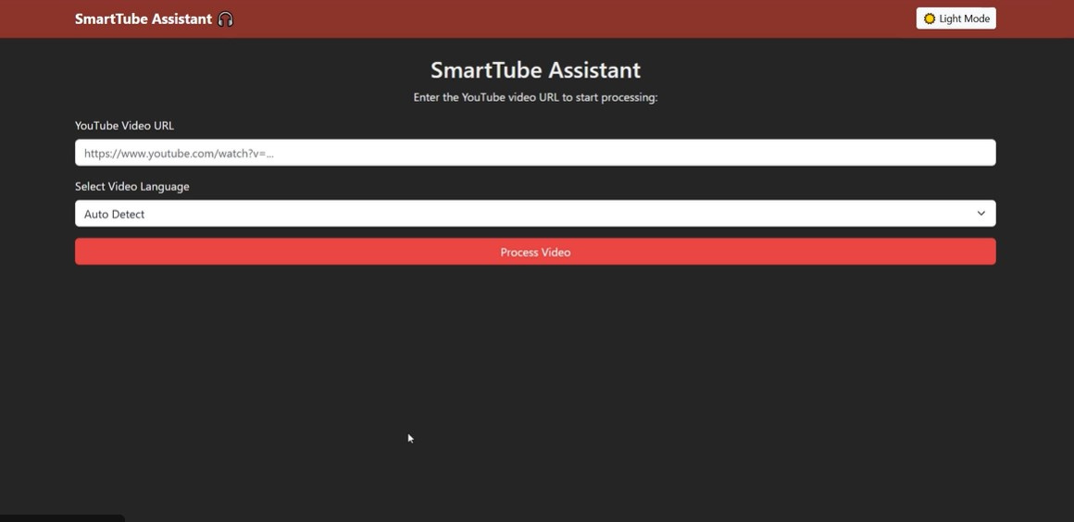
Home page

Slide 52
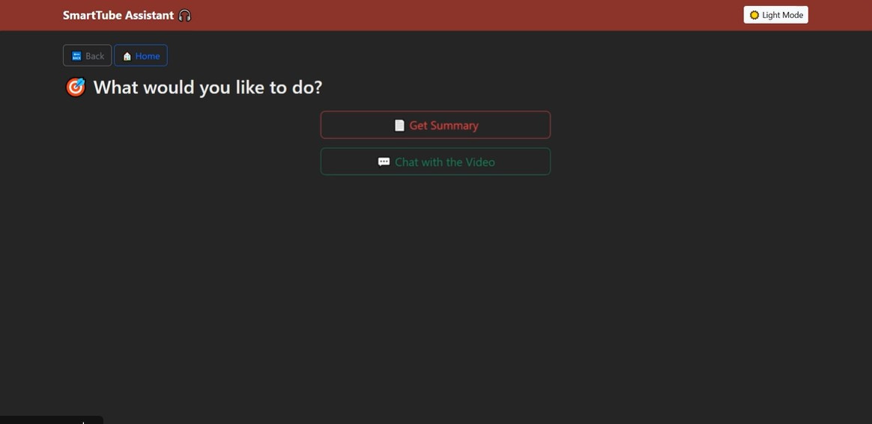
Click “Get Summary”

Slide 53
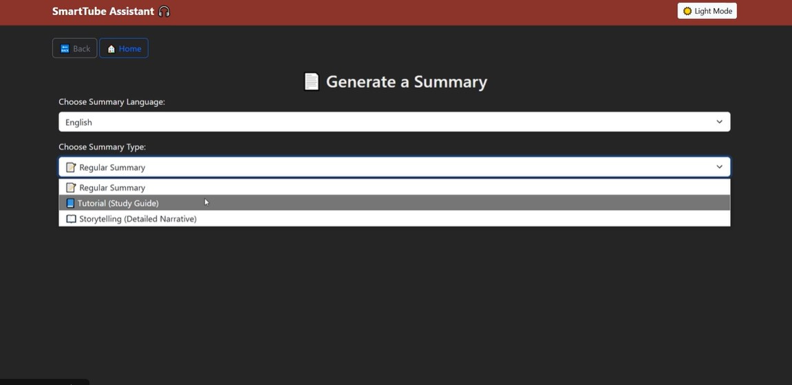
Choose Summary Type

Slide 54
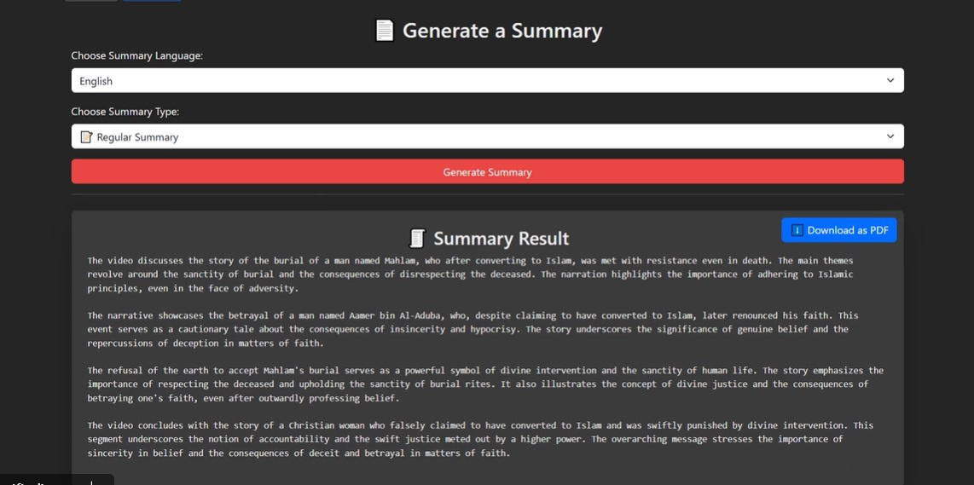
Summary Page

Slide 55
Click “chat with the video”

Slide 56
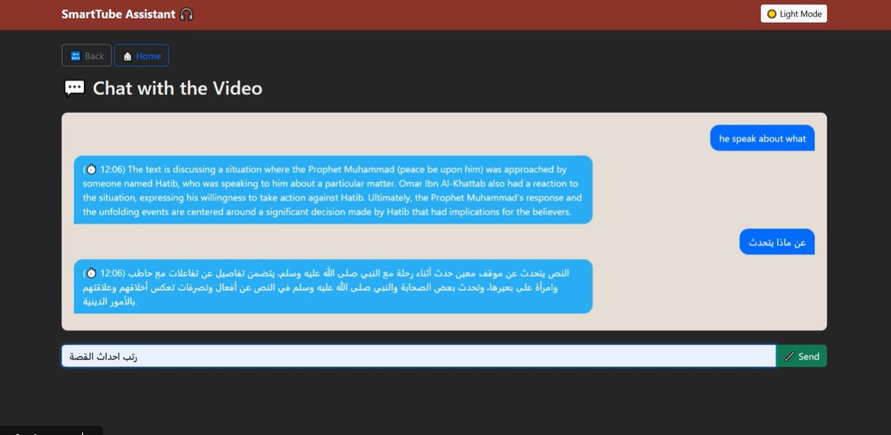
Chat with Video Page

Slide 57


FUTURE GOALS

Slide 58
FUTURE GOALS
Improve AI chat to handle multiple video sources in one conversation

Slide 59
FUTURE GOALS
Improve AI chat to handle multiple video sources in one conversation
Include more options for summary type

Slide 60
FUTURE GOALS
Improve AI chat to handle multiple video sources in one conversation
Include more options for summary type
Launch the project as an official application

Slide 61


PRESENTER
Mehdar
Saggaf
Student

Slide 62
PRESENTER
Mehdar
Saggaf
Student

